Slide 1
Federal Assets Sale and Transfer Act (FASTA)

Slide 2
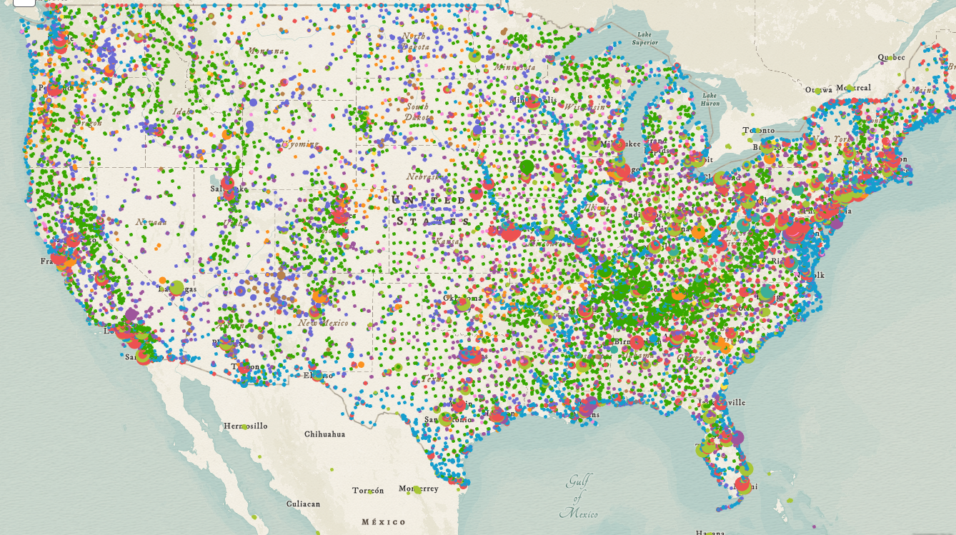
methodology
© 2019 CBRE | CONFIDENTIAL & PROPRIETARY

Slide 3
Methodology
FRPP
399,108 Assets
36,367 Installations
Civilian Properties
Excludes Dept. of Defense assets
Excludes national security assets
Civilian Properties
FASTA Eligible
Exclusions defined in FASTA law including:
Non-US assets
USPS, TVA, USAid assets
Certain uses including agriculture, conservation, flood control, etc.
109,179 Assets
27,180 Installations
FASTA Eligible
10,756 Assets
3,557 Installations
The project team developed a methodology to sort the data for easier assessment
A filtering approach was used to create recommended asset groups
Core Properties
FASTA Candidates
© 2019 CBRE | CONFIDENTIAL & PROPRIETARY

Slide 4
Methodology
FRPP
399,108 Assets
36,367 Installations
Core Properties
Excludes smaller properties and specialized uses including:
Owned assets with Replacement Value less than $1MM
Leased assets smaller than 25,000 SF
Acreage less than 3 acres
Specialized uses such as museums, prisons, monuments, etc.
Civilian Properties
109,179 Assets
27,180 Installations
FASTA Eligible
Recommended FRPP Asset Groupings | # of Assets | Square Feet | Replace-ment Value | Lease Costs | Acres | Headcount
Civilian Properties | 399,108 | 1,328MM | $930BB | $8.6BB | 9.6MM | 1,621,206
FASTA Eligible | 109,179 | 809MM | $436BB | $6.4BB | 0.9MM | 1,309,555
Core Properties | 10,756 | 685MM | $364BB | $4.8BB | 0.8MM | 1,021,150
Core Properties as a % of FASTA Eligible | 10% | 85% | 84% | 75% | 86% | 7.8%
10,756 Assets
3,557 Installations
Core Properties
FASTA Candidates
© 2019 CBRE | CONFIDENTIAL & PROPRIETARY

Slide 5
FRPP – Potential Data Gaps & Recommendations
POTENTIAL DATA GAPS:
RECOMMENDATIONS:
Enhance Verification & Validation procedures to identify outliers and data quality issues more comprehensively
Develop a structured approach to Installation and Sub-Installation identification
Review Office Building utilization(SF/person) outliers and gather Enhanced Data on likelier FASTA Candidates
Headcount
Utilization
O&M Expenses
Installation & Sub-Installation Identification
© 2019 CBRE | CONFIDENTIAL & PROPRIETARY

Slide 6
Key takeaways
1
Keep Focus on Disposal not Consolidation
2
3
4
Impact of Zoning
on Valuation
Agency Participation
FRPP Improvements
Primarily on Excess Land
Transactions will generate funding for additional work
Adding more time to FASTA requirements to Dispose of HVA
Future v. Current-Use Zoning creates a substantial difference in values
Recommend GSA to support re-zoning to a point
Critical to success
Encourage participation though partial retention of proceeds
Highlight overall FASTA success & benefits of those who participate
Better tracking of assets not fully occupied or do not meet Utilization targets
Recommendation to add Post-occupancy Utilization (headcount & unadjusted square footage)
5
6
7
Limited Utilization
Analysis
Few Higher Value Assets Ready for Quick Sale
Impact of Occupancy
on Valuation
Create an Enhanced Data Set of over 400 Office/Warehouse assets
Subset focused on in depth Utilization Analysis & Operating cost data review
Most likely to generate Lease savings or significant disposal proceeds to move into FASTA
Most HVA’s need greater than 1 year to sell due to many factors
i.e. Existing occupants, environmental remediation, zoning communications
Need FASTA funding to shorten timeline and maximize HVA opportunity
Even limited occupancy creates a negative impact and delays on Disposition Values and FASTA Candidates
New limited duration sale-leaseback to expedite disposals & generate funding for relo/consolidation options
© 2019 CBRE | CONFIDENTIAL & PROPRIETARY

